Slide 1
ML and Society
Feb 20, 2023

Slide 2
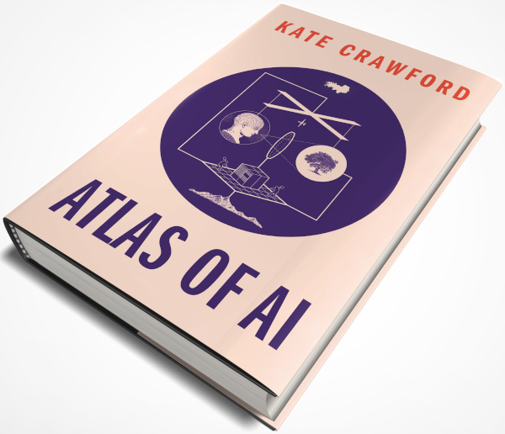
Passcode: Kate Crawford

Slide 3
Sit with your team!
Team 1 | Afzal | Cole | Navid | Tim
Team 2 | Aishwarya | Herman | Mads | Melvin
Team 3 | Daphkar | Juliana | Ibtida | Monica
Team 4 | Joe | Ken | Vedant | Zach
Team 5 | Chaitanya | Evan | Hitesh | Sushanth
Team 6 | Hannah | Harinee | Gabriella | Suradhya
Team 7 | Alex | Connor | Gopi | Shane | Thanh
Team 8 | Aditi | Connor | Jason | Mitali
Team 9 | Botsalano | Niharika | Vedang | Yunmei
Team 10 | Dhiraj | Frank | Kashyap | Michael
Rage students in Green. ML+Soc students in black

Slide 4
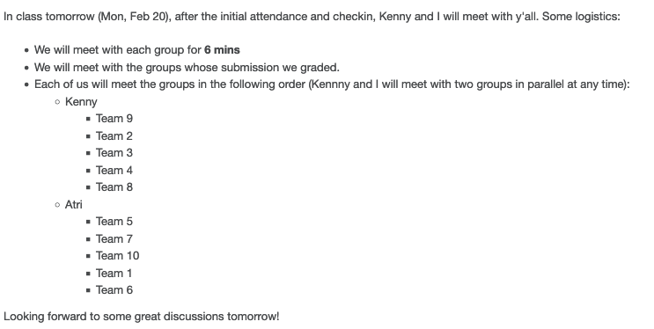
Team meetings

Slide 5
Break!

Slide 6
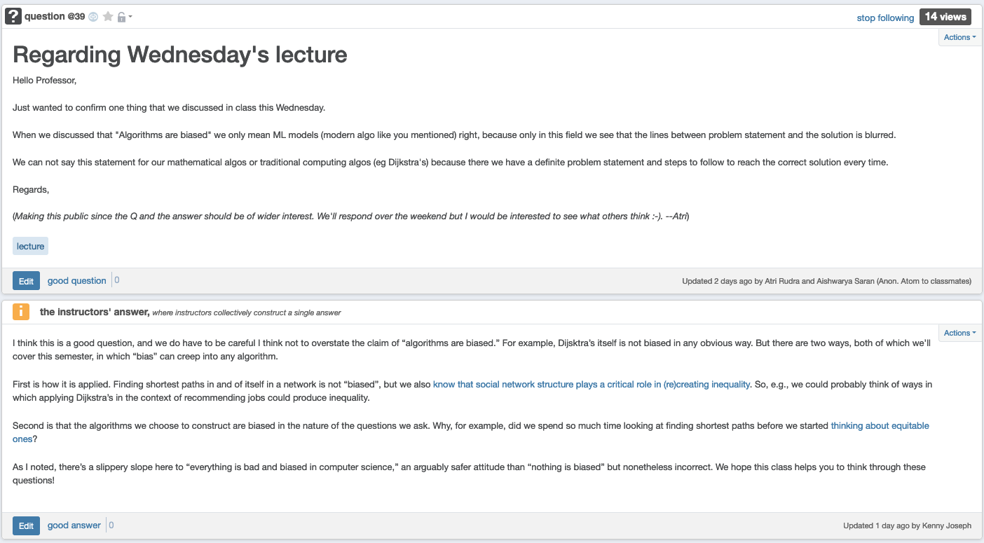
Are algorithms racist?

Slide 7
ML pipeline
Real world goal
Real world mechanism
Learning problem
Data collection mechanism
Which data to collect?
Data representation
Society
Target class/model
Deploy!
Evaluate error
Predict on test data
Model training
Training data set

Slide 8
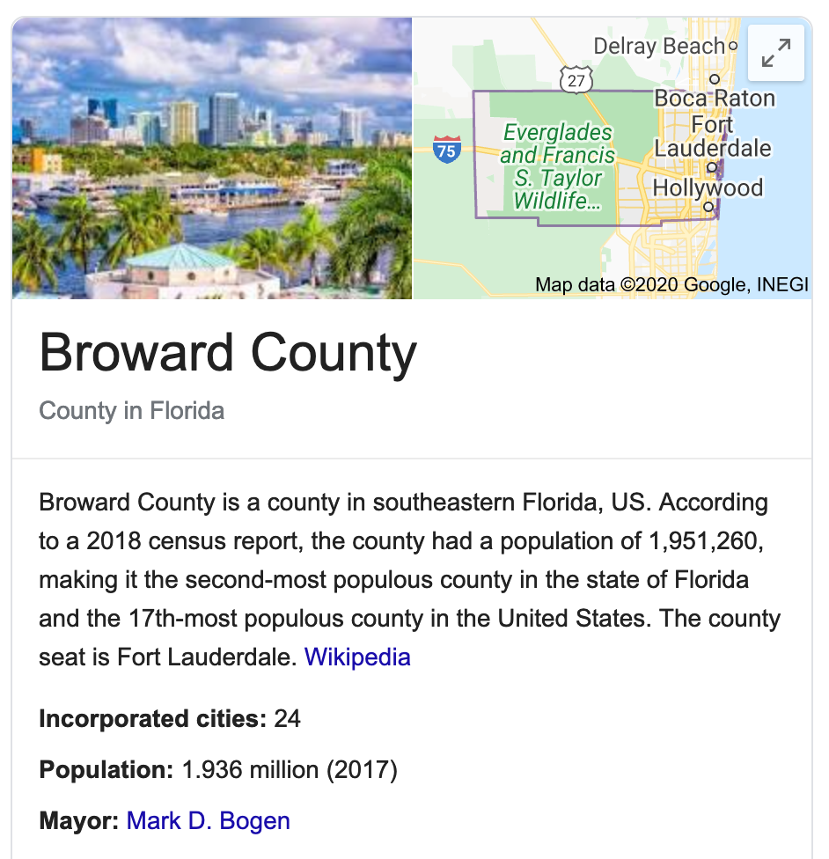
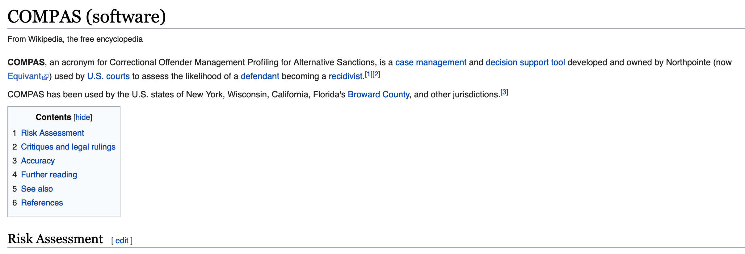
COMPAS

Slide 9
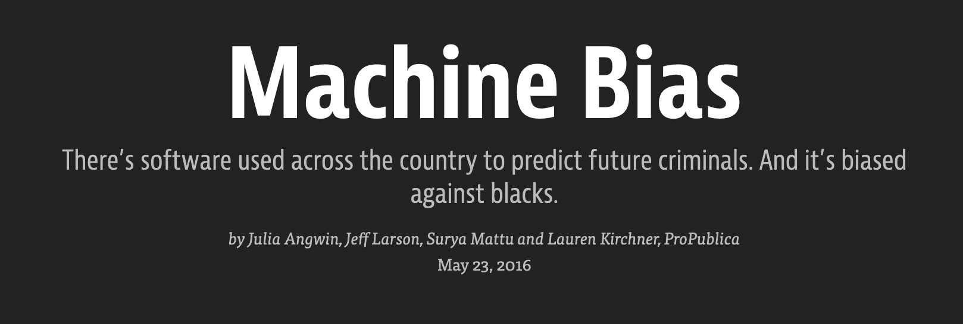

Slide 10
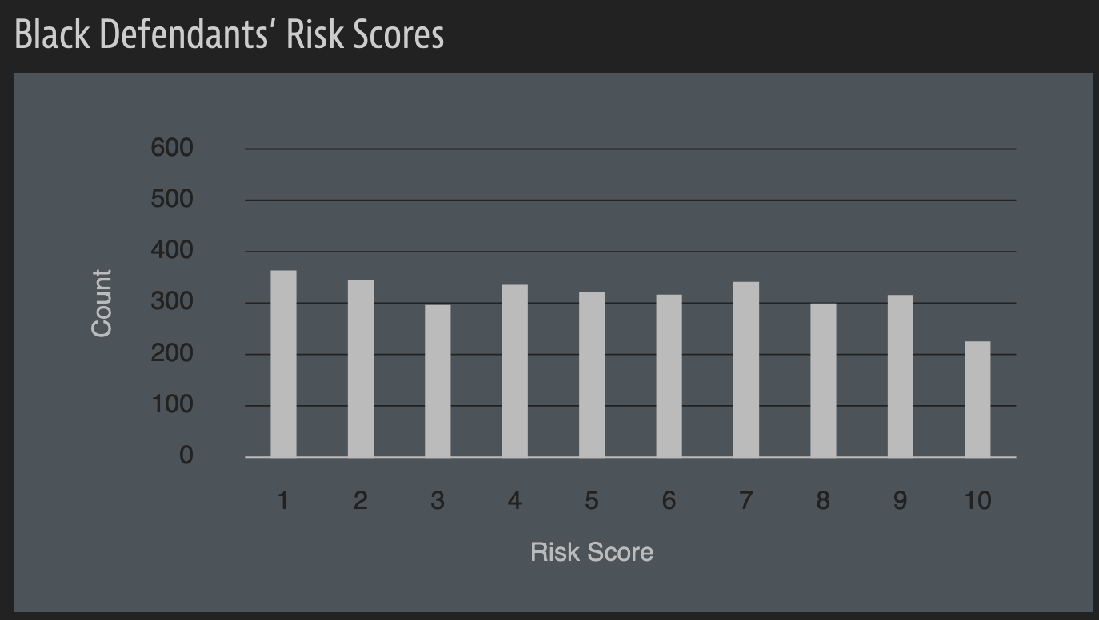
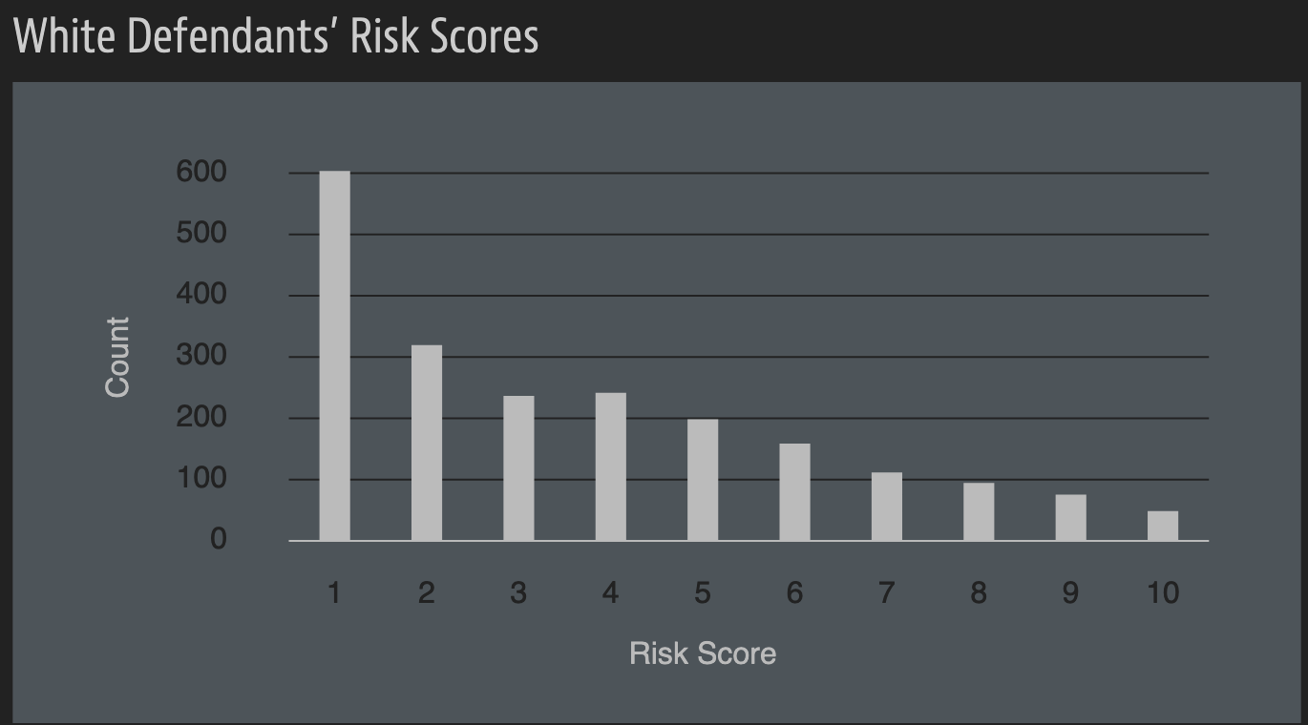
A sample of their result

Slide 11
A rejoinder

Slide 12
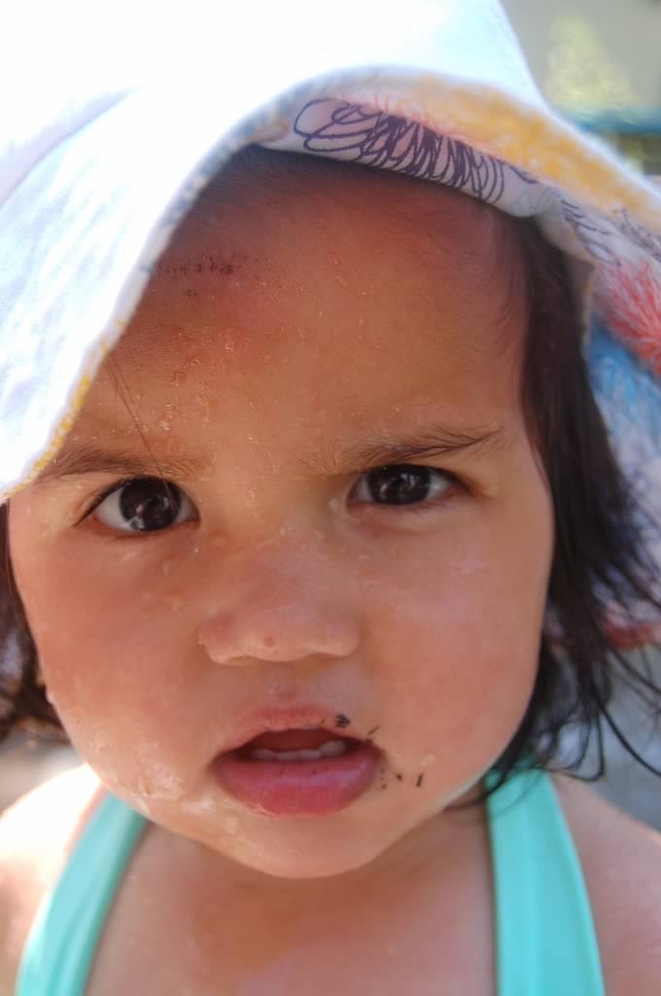
?

Slide 13
A walkthrough
Real world goal
Real world mechanism
Learning problem
Data collection mechanism
Which data to collect?
Data representation
Target class/model
Deploy!
Evaluate error
Predict on test data
Model training
Training data set

Slide 14
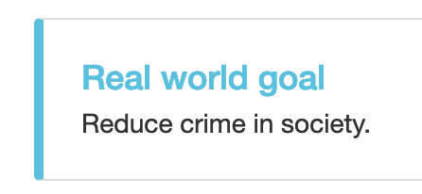
Real world goal
Real world goal

Slide 15
Real world mechanism
Real world goal
Real world mechanism

Slide 16
Learning problem
Target variable might not be obvious in other scenarios!
Real world goal
Real world mechanism
Learning problem

Slide 17
?

Slide 18
Data collection mechanism
Real world goal
Real world mechanism
Learning problem
Data collection mechanism

Slide 19
Which data to collect?
Real world goal
Real world mechanism
Learning problem
Data collection mechanism
Which data to collect?

Slide 20
Data representation
Real world goal
Real world mechanism
Learning problem
Data collection mechanism
Which data to collect?
Data representation

Slide 21
?

