Slide 1
ML and Society
Feb 23, 2023

Slide 2
Passcode: Kayla Krencik

Slide 3
Sit with your team!
Team 1 | Afzal | Cole | Navid | Tim
Team 2 | Aishwarya | Herman | Mads | Melvin
Team 3 | Daphkar | Juliana | Ibtida | Monica
Team 4 | Joe | Ken | Vedant | Zach
Team 5 | Chaitanya | Evan | Hitesh | Sushanth
Team 6 | Hannah | Harinee | Gabriella | Suradhya
Team 7 | Alex | Connor | Gopi | Shane | Thanh
Team 8 | Aditi | Connor | Jason | Mitali
Team 9 | Botsalano | Niharika | Vedang | Yunmei
Team 10 | Dhiraj | Frank | Kashyap | Michael
Rage students in Green. ML+Soc students in black

Slide 4
ML pipeline
Real world goal
Real world mechanism
Learning problem
Data collection mechanism
Which data to collect?
Data representation
Society
Target class/model
Deploy!
Evaluate error
Predict on test data
Model training
Training data set

Slide 5
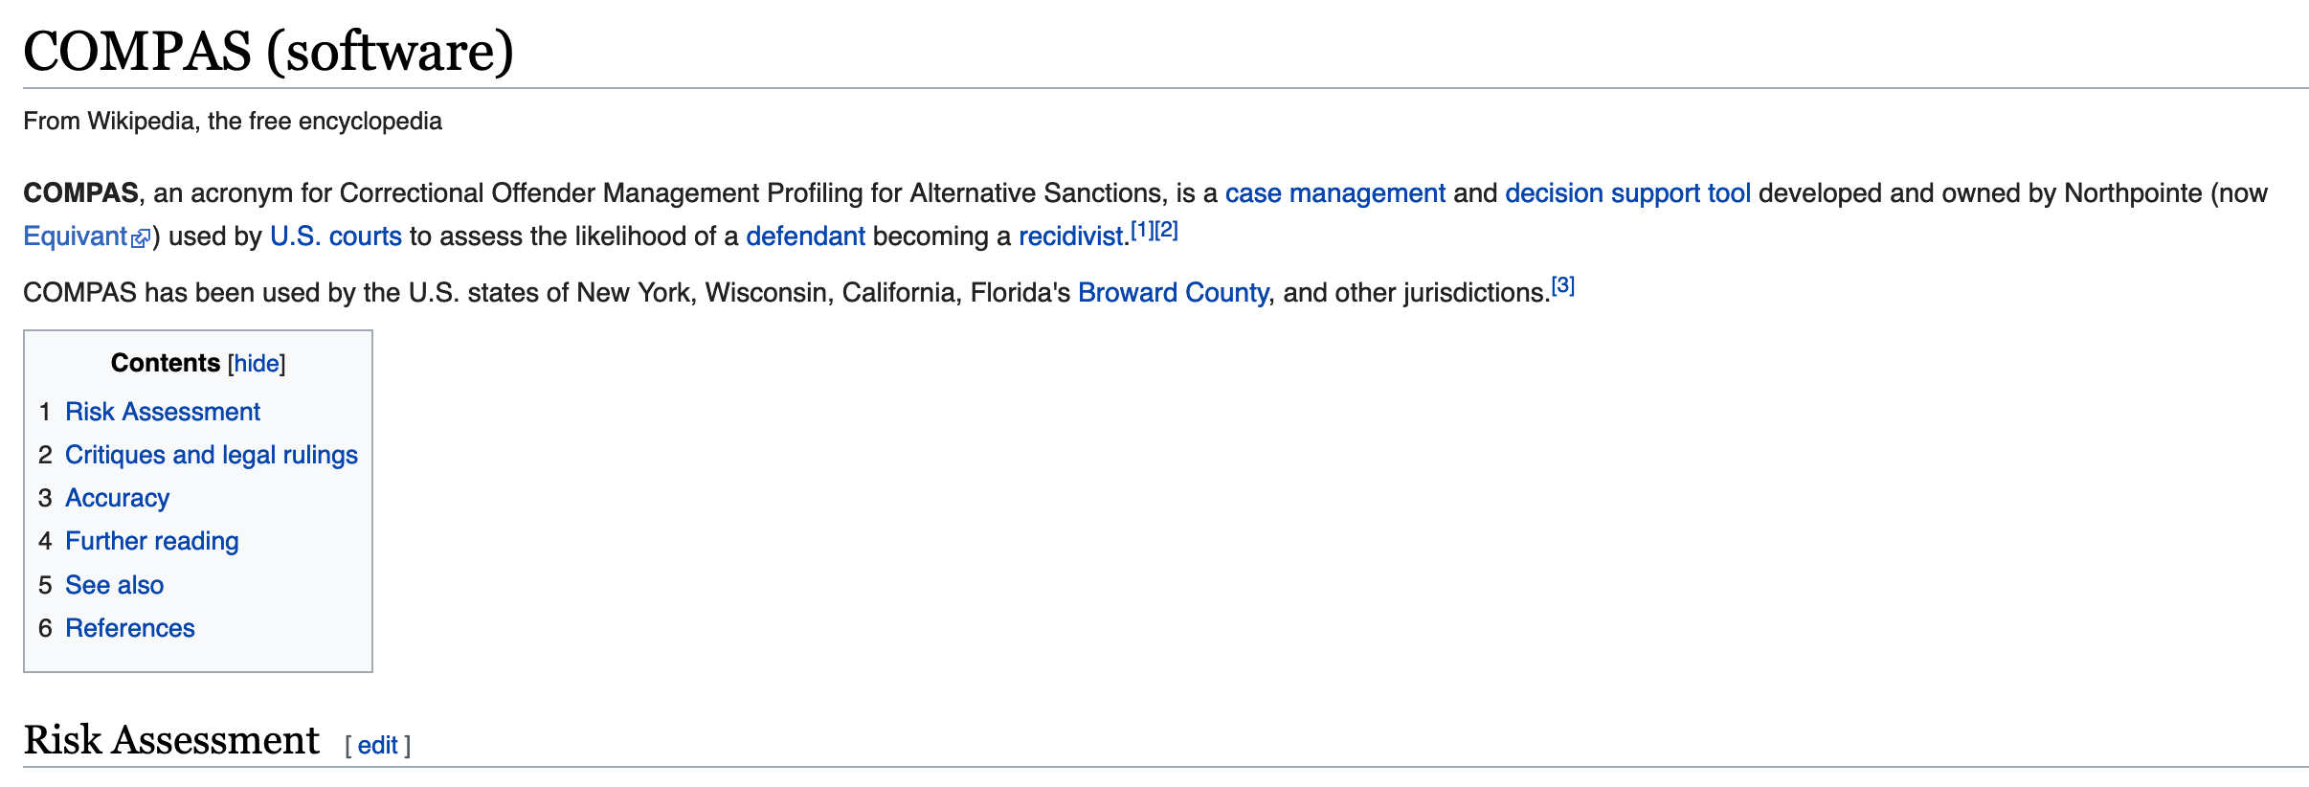
COMPAS

Slide 6
A walkthrough
Real world goal
Real world mechanism
Learning problem
Data collection mechanism
Which data to collect?
Data representation
Target class/model
Deploy!
Evaluate error
Predict on test data
Model training
Training data set

Slide 7
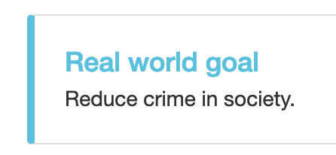
Real world goal
Real world goal

Slide 8
Real world mechanism
Real world goal
Real world mechanism

Slide 9
Learning problem
Target variable might not be obvious in other scenarios!
Real world goal
Real world mechanism
Learning problem

Slide 10
Data collection mechanism
Real world goal
Real world mechanism
Learning problem
Data collection mechanism

Slide 11
?

Slide 12
Which data to collect?
Real world goal
Real world mechanism
Learning problem
Data collection mechanism
Which data to collect?

Slide 13
Data representation
Real world goal
Real world mechanism
Learning problem
Data collection mechanism
Which data to collect?
Data representation

Slide 14
?

Slide 15
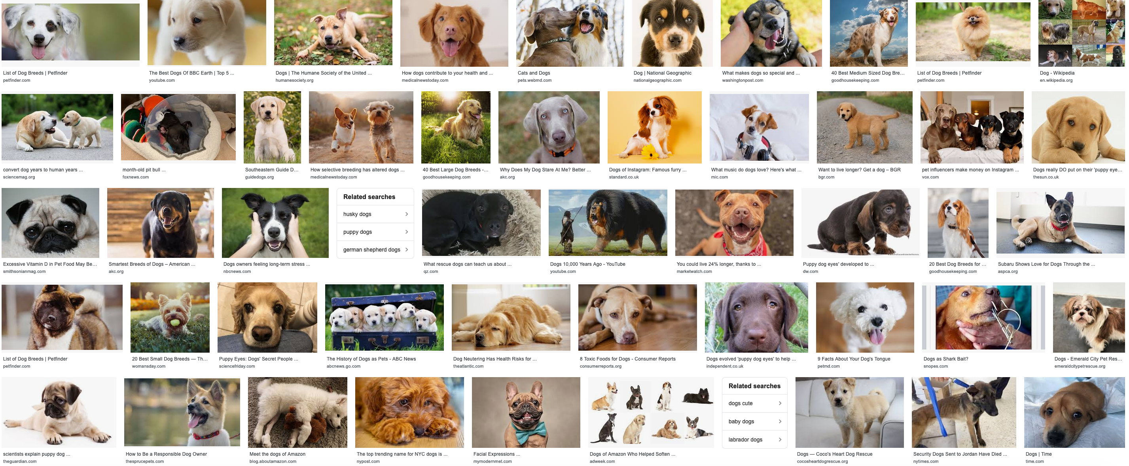
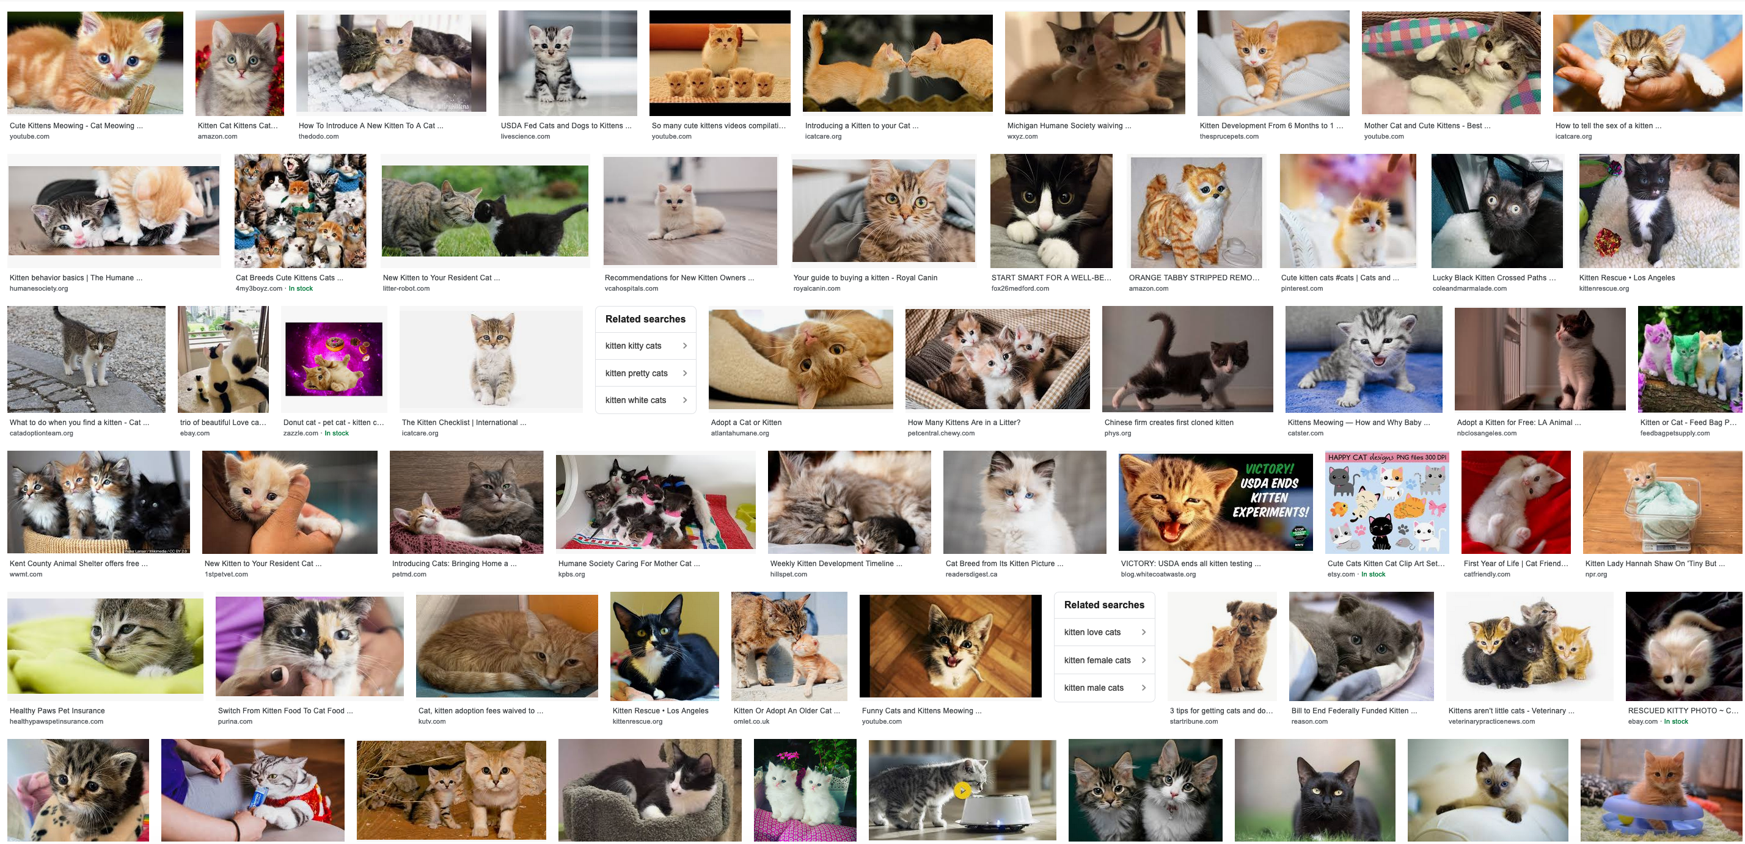
Target class/model
Real world goal
Real world mechanism
Learning problem
Data collection mechanism
Which data to collect?
Data representation
Target class/model
dog
Linear models
f
cat

Slide 16
Cartoon of how linear model works
Can you find a “better” line?

Slide 17
Training data set
Real world goal
Real world mechanism
Learning problem
Data collection mechanism
Which data to collect?
Data representation
Target class/model
Training data set

Slide 18
Pick (random) half of the dataset

Slide 19
Model training
Real world goal
Real world mechanism
Learning problem
Data collection mechanism
Which data to collect?
Data representation
Target class/model
Model training
Training data set

Slide 20
?

Slide 21
Predict on test data
Real world goal
Real world mechanism
Learning problem
Data collection mechanism
Which data to collect?
Data representation
Target class/model
Predict on test data
Model training
Training data set

Slide 22
Evaluate error
Real world goal
Real world mechanism
Learning problem
Data collection mechanism
Which data to collect?
Data representation
Target class/model
Evaluate error
Predict on test data
Model training
Training data set

Slide 23
?

Slide 24
Relation to problem statement
Real world goal
Real world mechanism
Learning problem
Data collection mechanism
Which data to collect?
Data representation
Target class/model
Problem independent techniques
Evaluate error
Predict on test data
Model training
Training data set

Slide 25
?

Slide 26
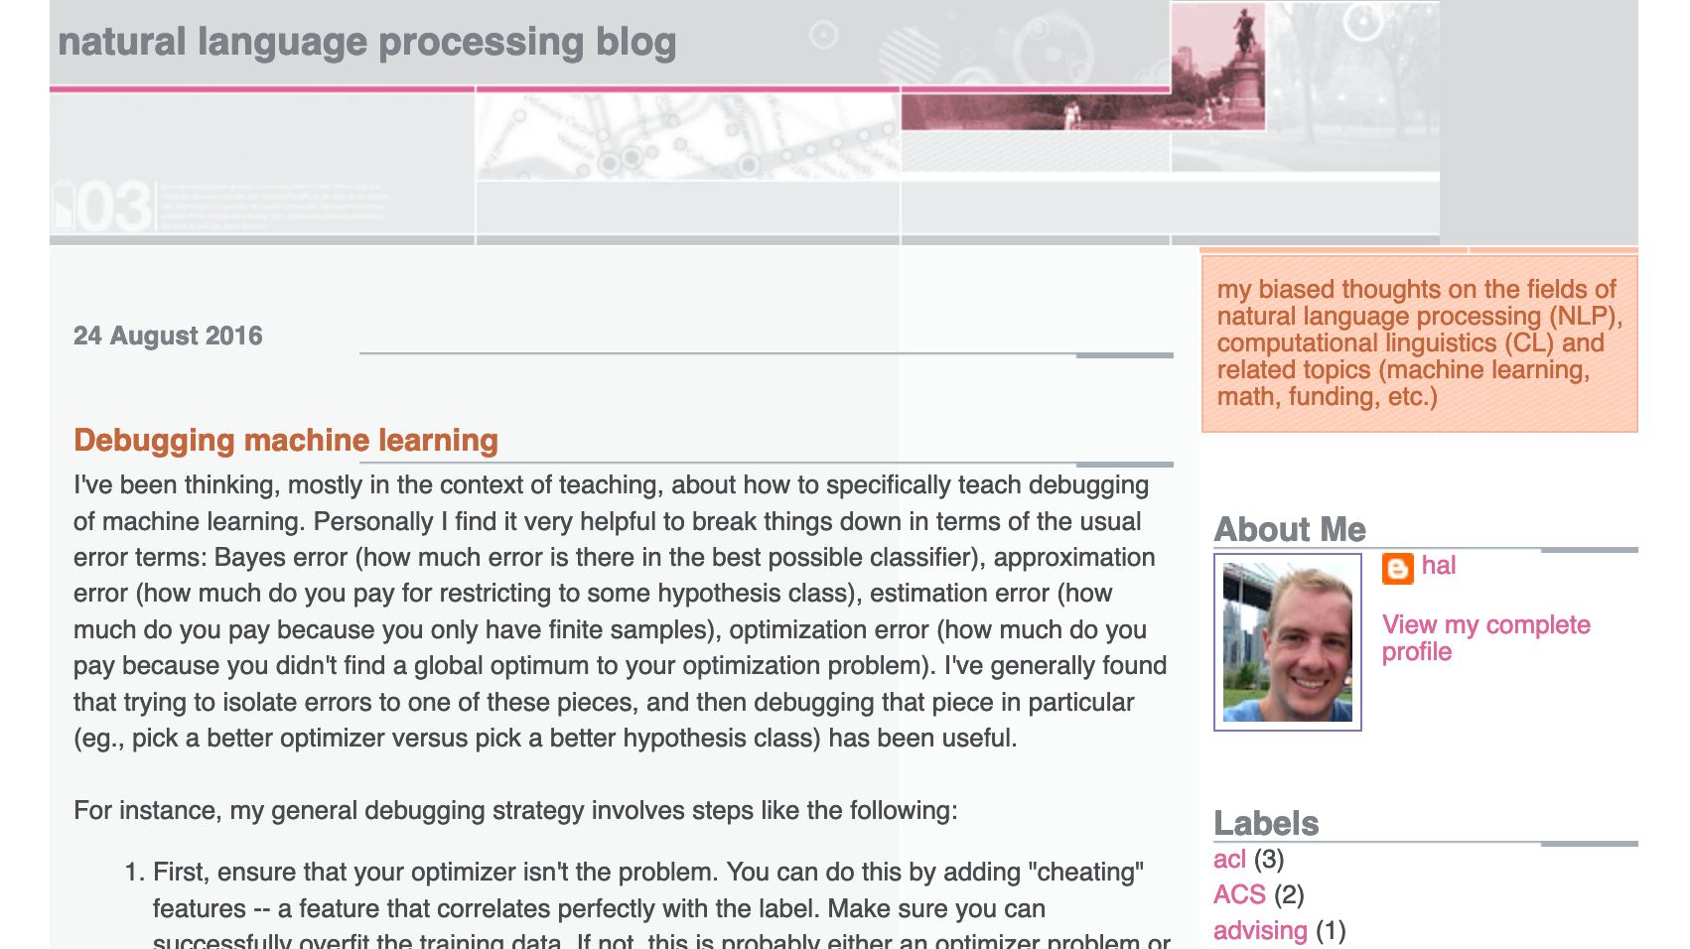
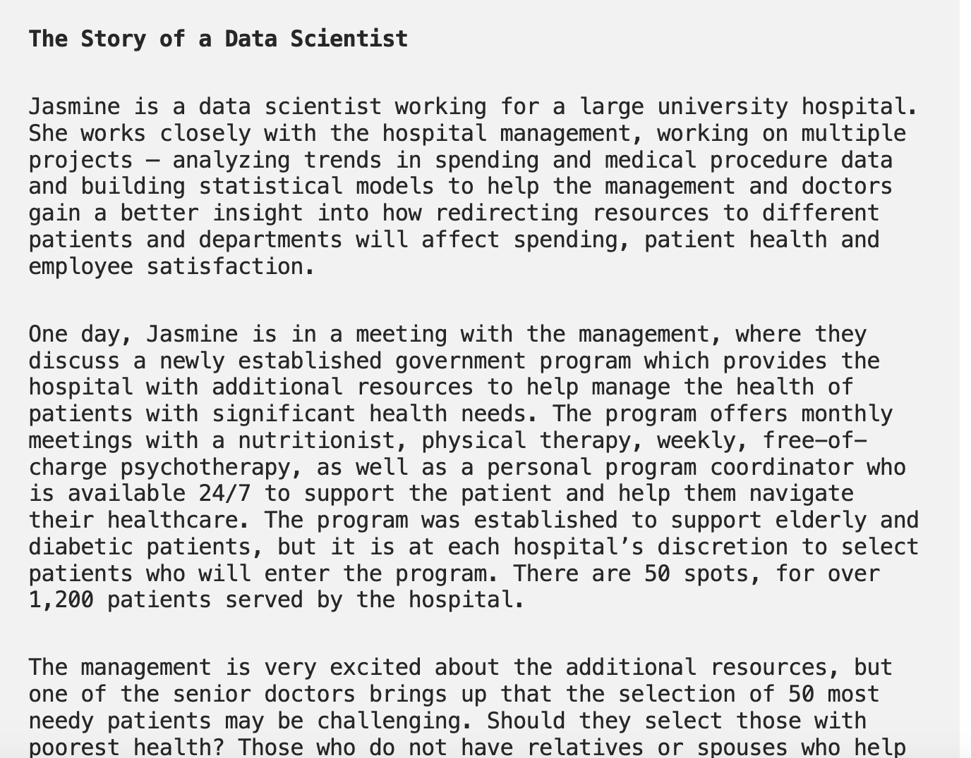
Three problems to consider
Ad display example
Hospital trying to utilize new govt program
Third example: YOU decide!

Slide 27
Real world goal
Real world goal

Slide 28
Real world goal: General thoughts
Real world goal
This step generally done at higher management level
Translating this into something concrete needs remaining steps

Slide 29
?

Slide 30
Real world mechanism
Real world goal
Real world mechanism

Slide 31
Real world mechanism: General thoughts
Is improving ad display the best option?
Real world goal
Real world mechanism
ALWAYS question if the mechanism captures well the real life goal
Doctors vs. management in Example 2
There can be competing/incompatible mechanisms
CONVENIENCE trap!

Slide 32
?

Slide 33
Learning problem
Real world goal
Real world mechanism
Learning problem

Slide 34
Learning problem: General thoughts
Real world goal
Real world mechanism
Learning problem
Decide NOT to use learning
Use of proxies for the real target variable
Some has to decide between competing target variables
Choosing the learning problem can have big consequence!
Convenience trap

Slide 35
Real world goal: Your choice
Real world goal

Slide 36
Real world mechanism: Your choice
Real world goal
Real world mechanism

Slide 37
Learning problem: Your choice
Real world goal
Real world mechanism
Learning problem

Slide 38
?

